Slide 1
Employee Performance Analysis using Excel
Student name: Krushika Jain
Register no: 312215916
Department: B.com(Accounting and Finance)
College: Shri Shankarlal Sundarbai shasun Jain College for women

Slide 2
PROJECT TITLE
EMPLOYEE PERFORMANCE ANALYSIS USING EXCEL

Slide 3
AGENDA
Problem Statement
Project Overview
End Users
Our Solution and Proposition
Dataset Description
Modelling Approach
Results and Discussion
Conclusion

Slide 4
1) PROBLEM STATEMENT
IDENTIFIED ISSUES
Inadequate objective performance indicators.a summary of typical difficulties in performance measurement and improvement.
It's challenging to pinpoint underachievers.
Inconsistent feedback and performance reports.

Slide 5
2) PROJECT OVERVIEW
PROJECT GOALS
To determine the KPIs, or key performance indicators.
To create a thorough framework for analysis.
To offer practical insights for enhancing performance.

Slide 6
3) END USERS
TARGET AUDIENCE
HR departments.
Senior management and executives.
Team leads and department heads.

Slide 7
4) OUR SOLUTION AND PROPOSITION
VALUE PROPOSITION
enhanced ability to make decisions.
Increased retention and engagement of staff.
The strategic matching of employee performance to organizational objectives.

Slide 8
5) DATA-SET DESCRIPTION
DATA SOURCES
HR records, performance reviews, productivity metrics.
External benchmarks and industry standards.

Slide 9
6) MODELLING APPROACH
SELECTION OF MODELS
Description of models used (e.g., regression, classification, clustering).
Justification for model selection.

Slide 10
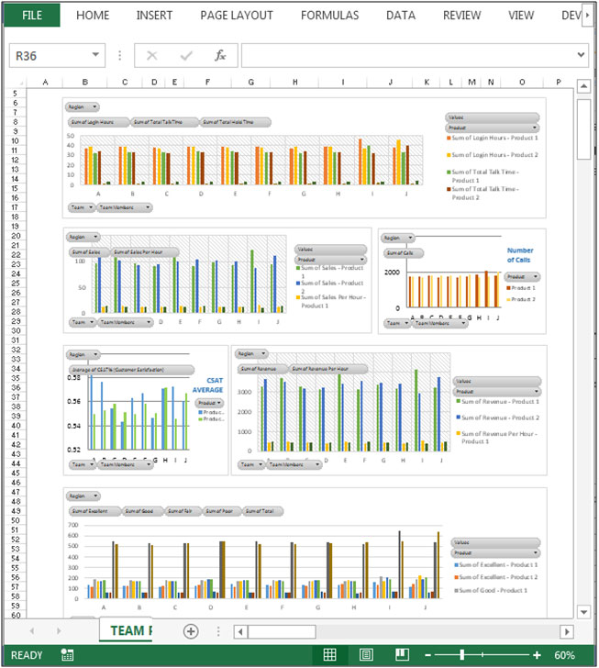
7) RESULTS AND DISCUSSION
RESULTS BY EXCEL DATA

Slide 11
8) CONCLUSION
CLOSING REMARKS
A request for inquiries and dialogue.
Contact information for follow-up.

Slide 12
THANK YOU

